Slide 1








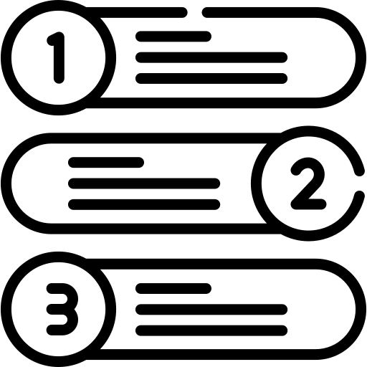




TCG and Opkey Integrated Solution
LEGEND:
Manual
Gen AI
Automation
Accelerating test design and automation testcases generation leveraging Gen AI with a Human-in-the-Loop approach
Work In Progress
Upload Requirement Doc
(pdf / word / user stories)
Requirement Analysis
Requirement Summary
Test Case
Type Selection
Test Case
Test Steps
Review & Finalize Test Cases
Test Case
Upload Template
Upload
To Opkey
Trigger Opkey APIs
Login API
Opkey API endpoint
Data: Opkey Username and API key
Choose Project API
Opkey API endpoint
Data: Project Name
Create Automation Testcases
Opkey API endpoint
Data: Requirement Description, Manual testcases and login info
Return Array of Testcases
Testcase ID
Testcase Name and Test URL
Run the suite in Opkey
Final Test Results
Opkey API Engine
Work In Progress
Work In Progress
Completed

